Slide 1
Hey all!

Slide 2
Which hat I wear today?
Easy: Phi Suea House

Slide 3
Where the Guests come from: Thailand, Malaysia, Germany, Japan, Hong Kong, Sweden, Singapore,
Switzerland

Slide 4
Where the Guests come from/business areas: 28% Solar/Renewable Energy
24% Universities/Institutes/Schools
17% Friends of Phi Suea House
15% Industry
7% Traditional Energy Segment 4% Finance Industry
3% Permaculture Originations
2% Embassy/Consulates, Chamber of Commerce Organizations

Slide 5
100% nice people

Slide 6
Two Milestones in the past:
Test run start: 20.03.2015
Regular start: 29.01.2016

Slide 7
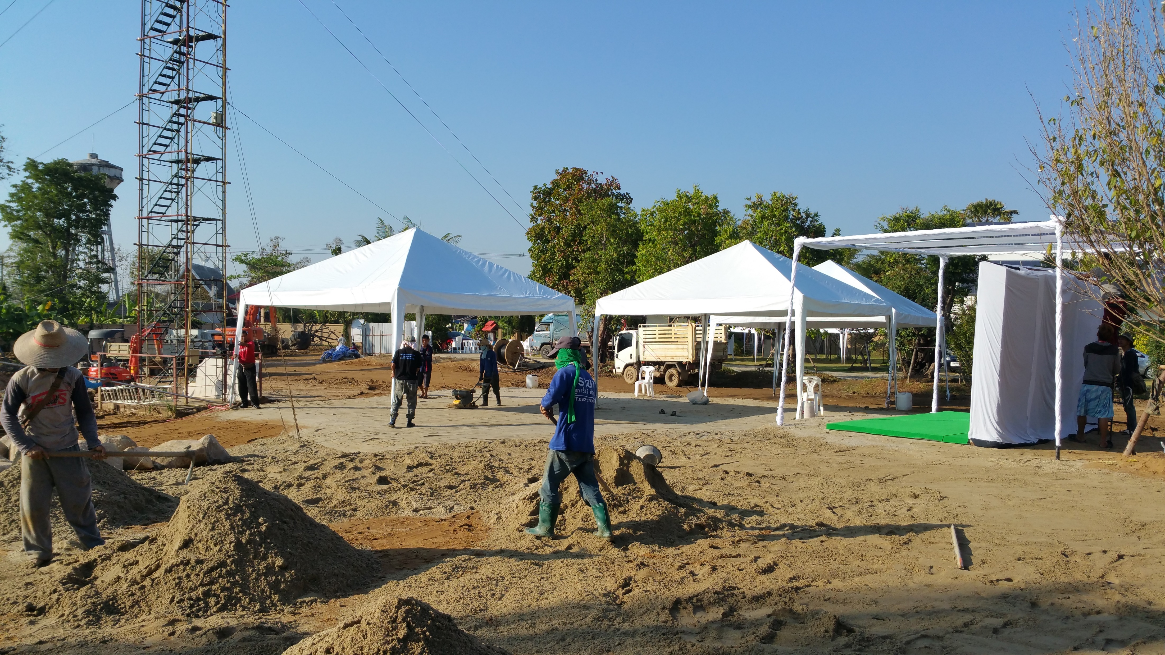
Two years back…

Slide 8
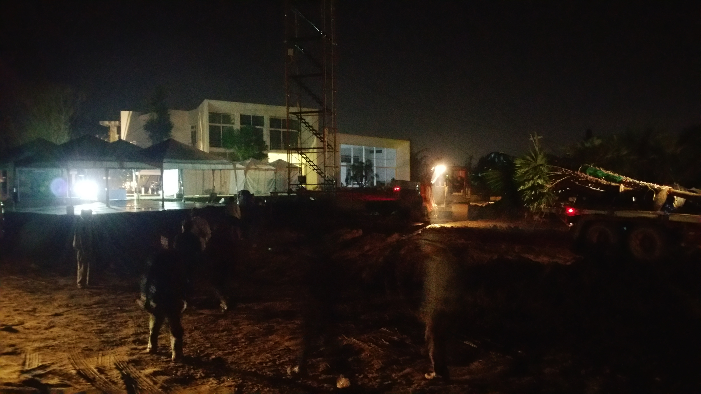
Two years back…

Slide 9
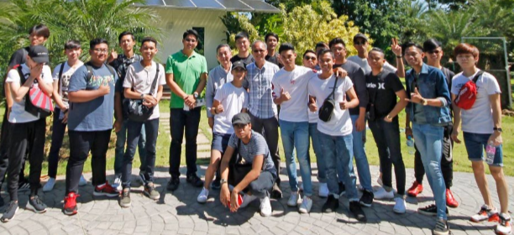
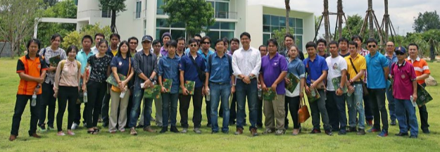
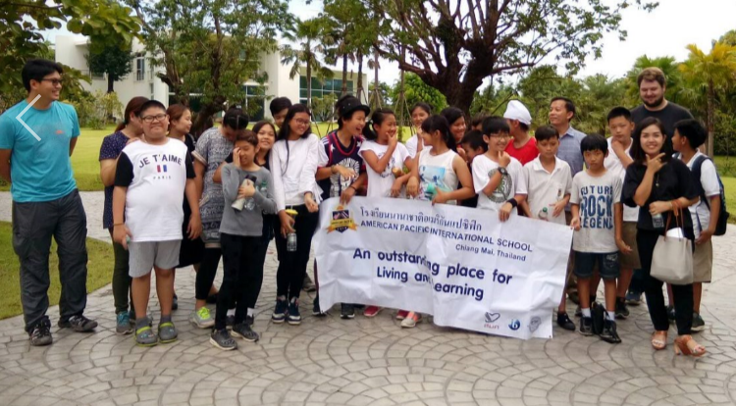
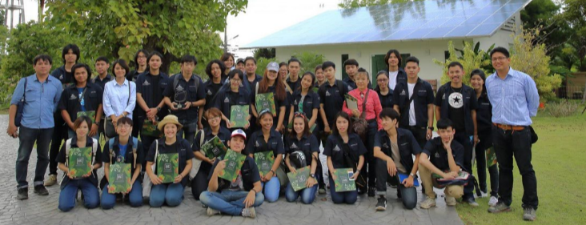
>1000 visitors since starting

Slide 10
People asked us:
Why haven’t you let us participate with the development at early stage?

Slide 11
Thank you all for challenging us.
Now it is our time to fulfill
our promise. Details about it a bit later.

Slide 12
Hydrogen has great supporters - everywhere

Slide 13
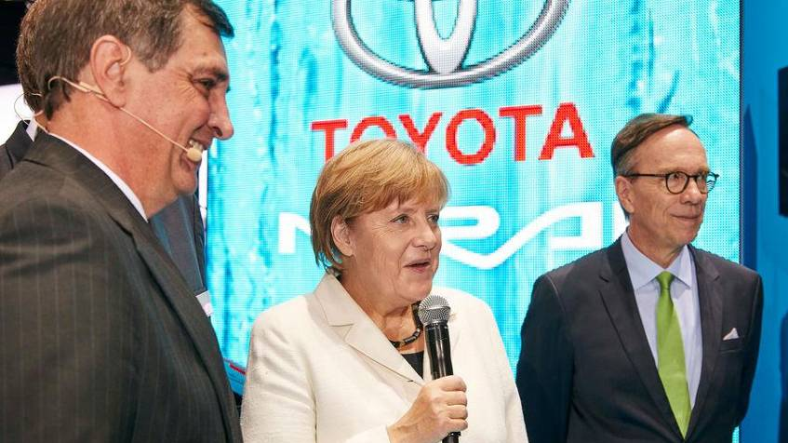
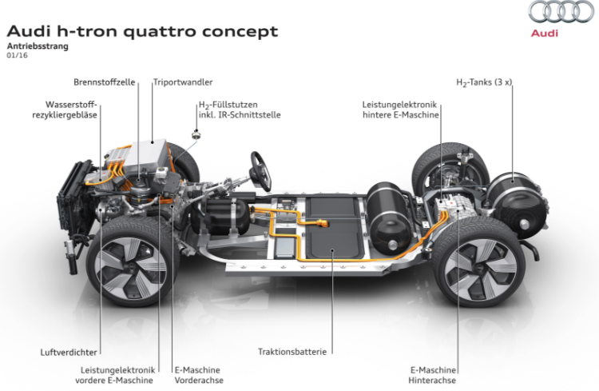
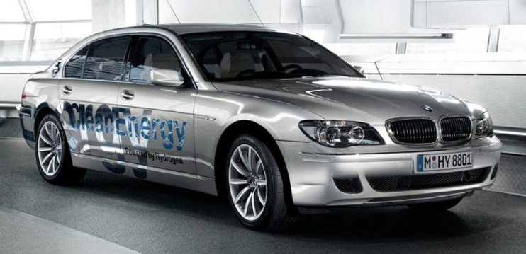
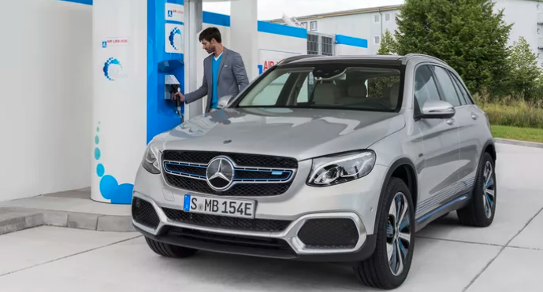
Hydrogen is compelling

Slide 14
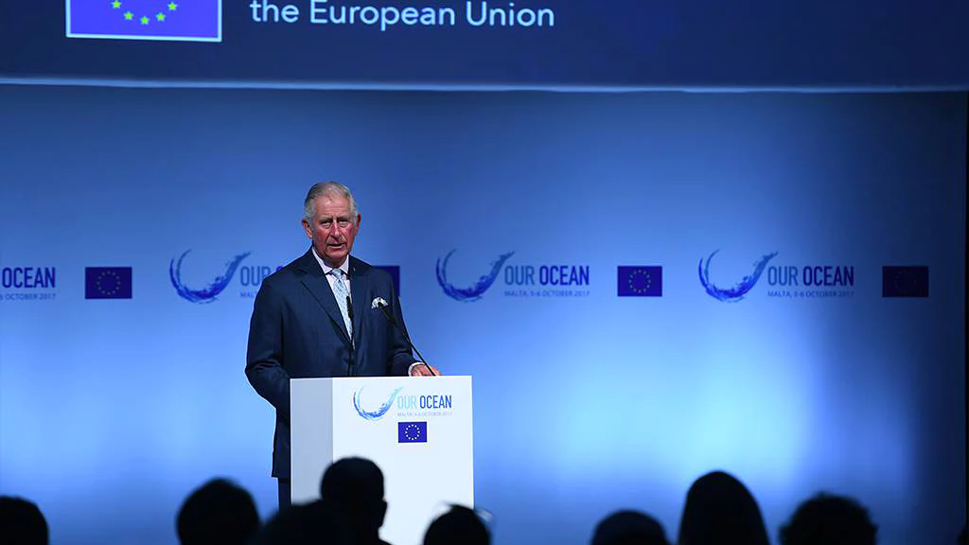
Hydrogen is compelling

Slide 15
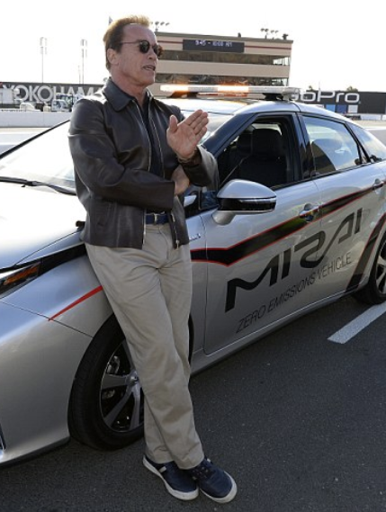
Hydrogen is compelling

Slide 16
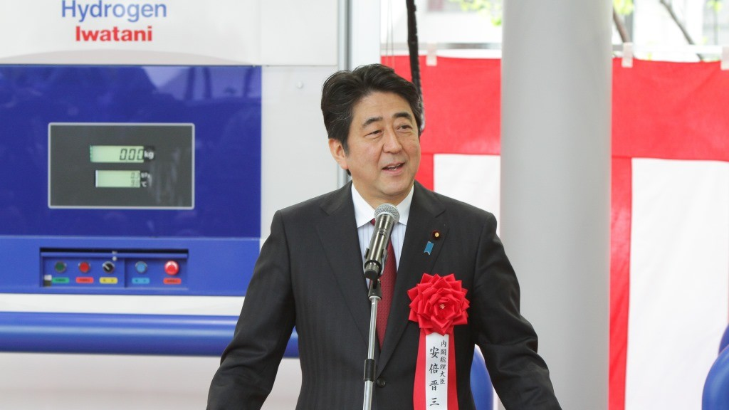
Hydrogen is compelling

Slide 17
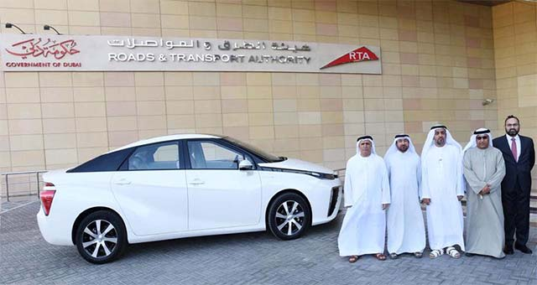
Hydrogen is compelling

Slide 18
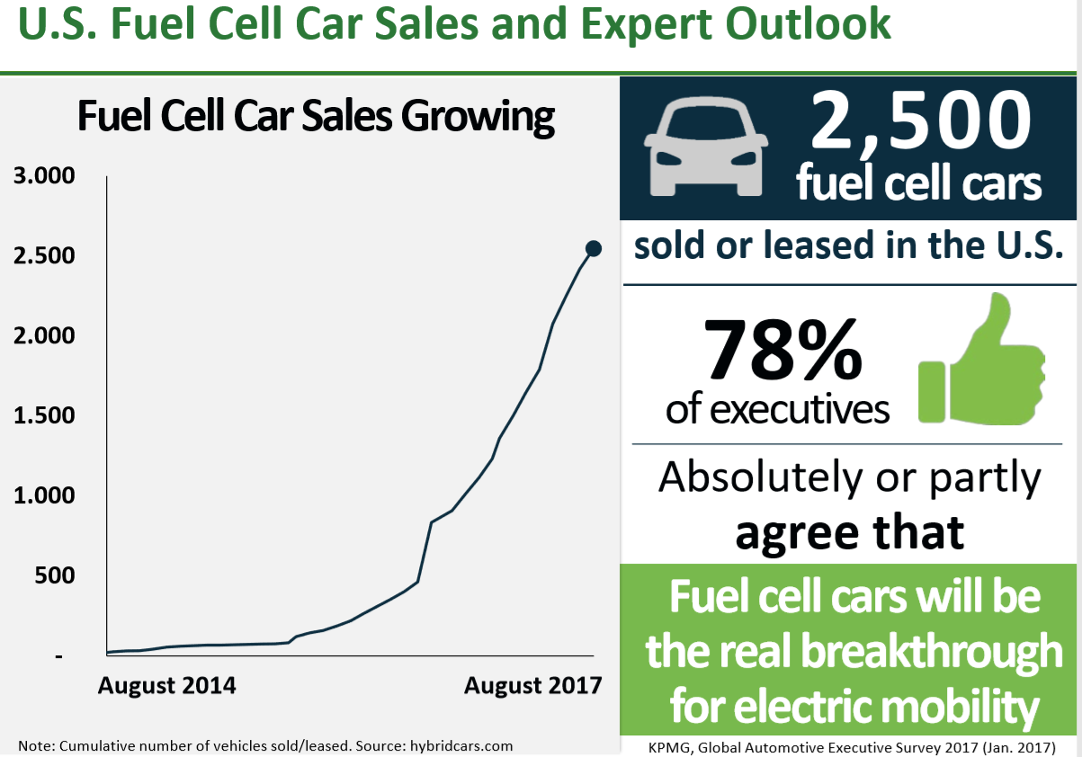

Slide 19
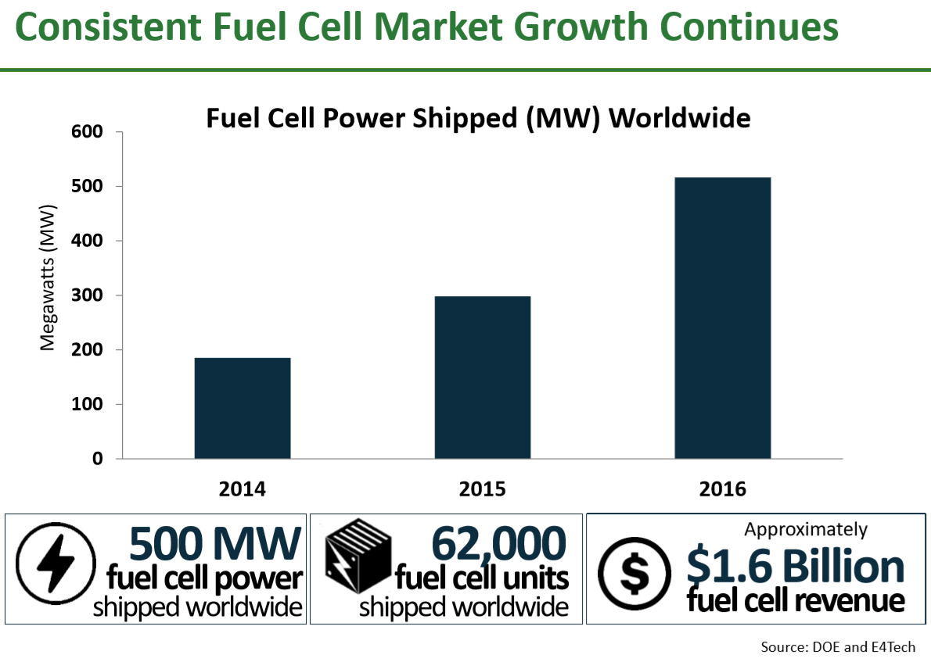

Slide 21
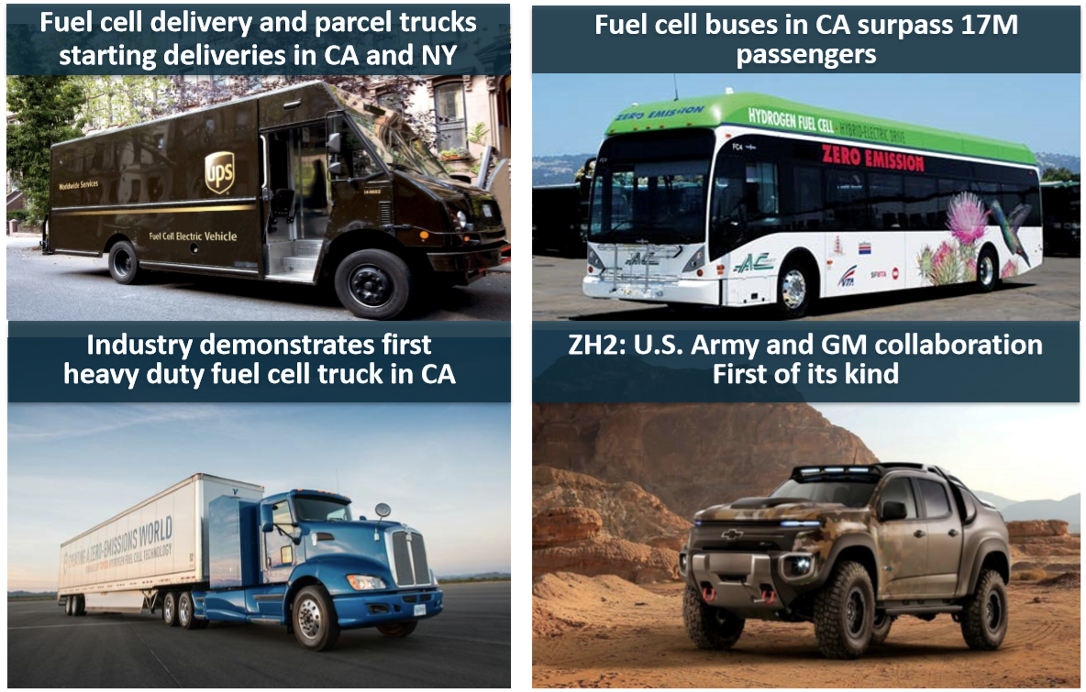

Slide 22
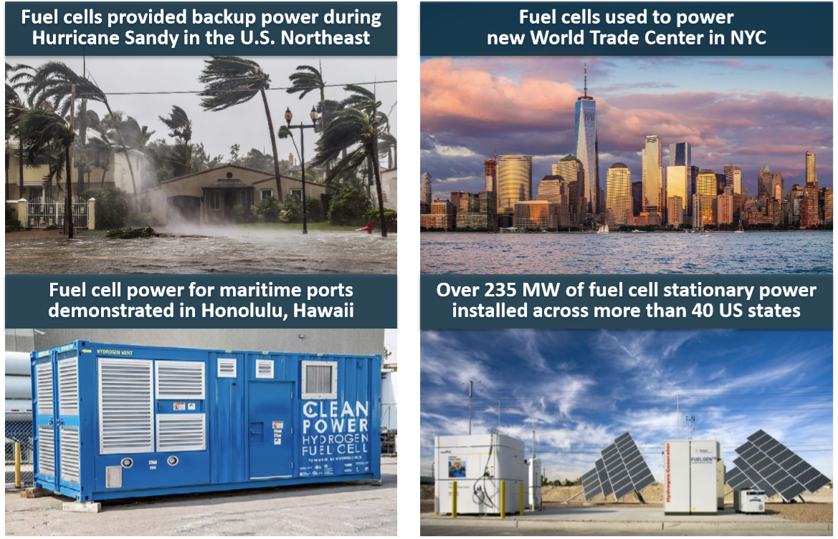

Slide 23
IF this is all true, why I can’t see the Fuel Cells around me?

Slide 24
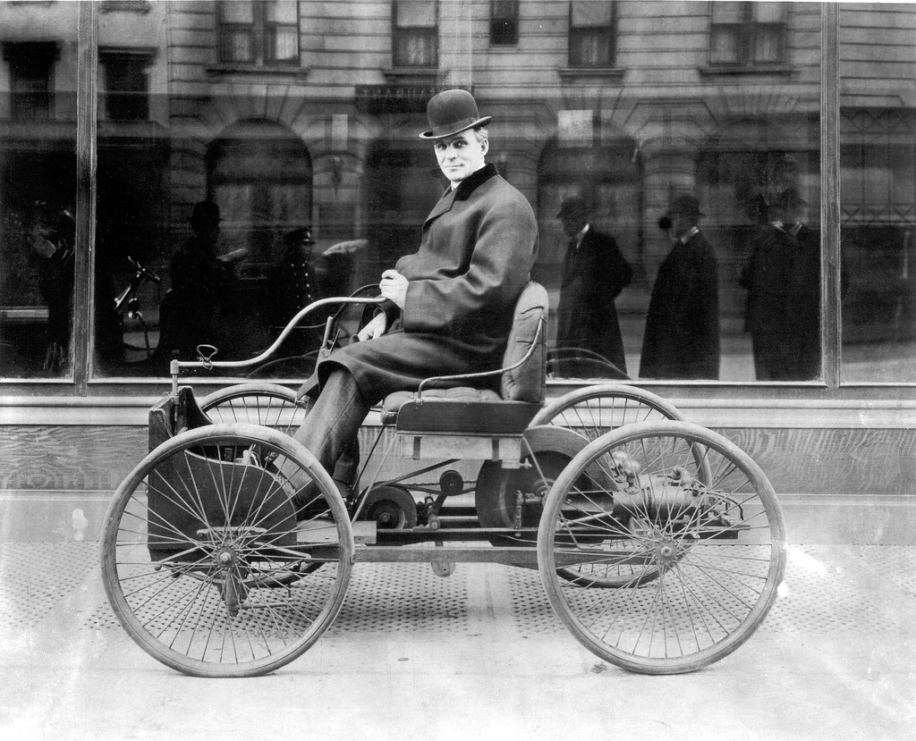
Ford Quadricycle 1896

Slide 25
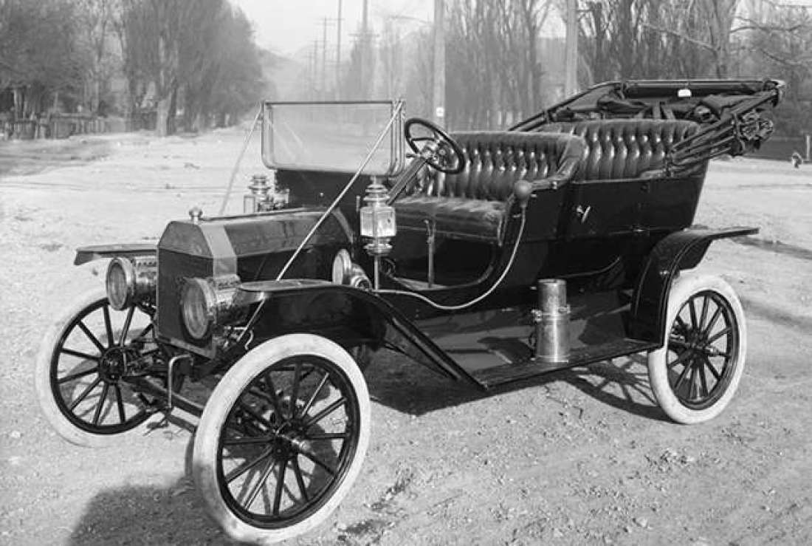
Ford T 1908

Slide 26
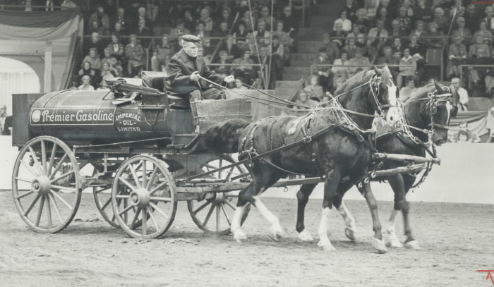
Gasoline Infrastructure

Slide 28
Green Hydrogen Refueling Station

Slide 29
We will establish a public-private partnership between Phi Suea House, Industry supporters, Individuals and research Organizations / Universities to establish the first green hydrogen refueling station in SE/Asia.

Slide 30
How we start?
Today: Basic Information Celebrate the start – Laying Symbolic Foundation Stone

Slide 31
How we start?
2) Setup of Office and Communication-Platform (end Feb)

Slide 32
How we start?
Establish Advisory Committee (mid March)
Establish Working Groups (mid March)

Slide 33
Be part of the pioneer team! Build the first Green Hydrogen refueling station in SE/Asia.
Research – Learn – Share - Discuss – Build Experience – Improve
Develop economic modelling tools
for scalable solutions in SE/Asia

Slide 34
Thank you!
Q&A

